Slide 1
Ve 280 Programming and Introductory Data Structures
Fibonacci Heap
Learning Objectives:
Know how a Fibonacci heap is implemented
Know the performance advantage of Fibonacci heap over binary heap

Slide 2
Fibonacci Heap
A mergeable heap, which supports the following operations
insert: insert a new item into the heap
getMin: get item with min key
extractMin: remove and return an item with min key
makeHeap: create a new empty heap
union(H₁,H₂): create and return a new heap that contains all the elements of heaps H₁ and H₂. Heaps H₁ and H₂ are destroyed by this operation
Additionally, Fibonacci heap supports
decreaseKey(Node x, Key k): decrease the key of node x to a smaller value k and restore the heap property

Slide 3
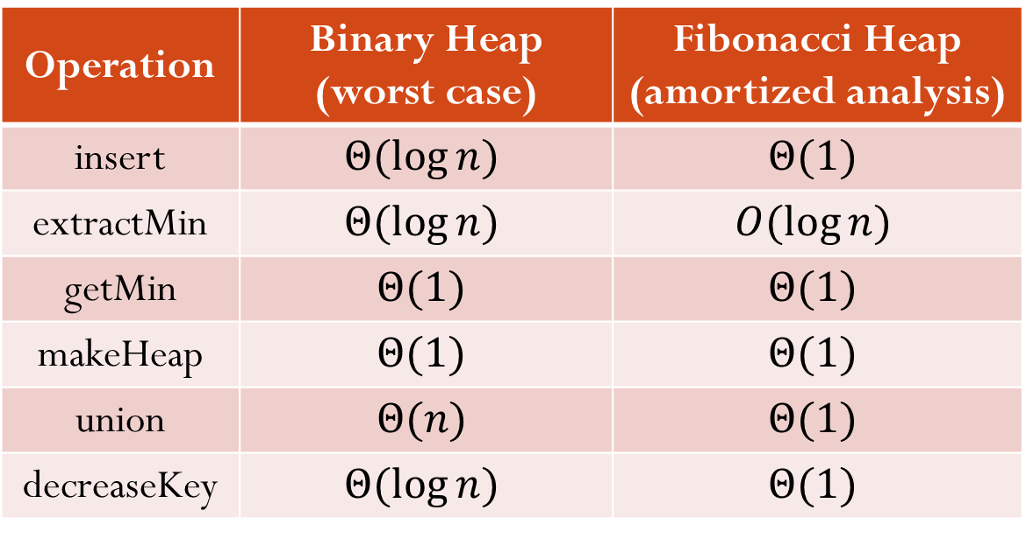
Runtime Complexity Comparison
Operation | Binary Heap (worst case) | Fibonacci Heap (amortized analysis)
insert | $$Θ(\log{n})$$ | $$Θ(1)$$
extractMin | $$Θ(\log{n})$$ | $$O(\log{n})$$
getMin | $$Θ(1)$$ | $$Θ(1)$$
makeHeap | $$Θ(1)$$ | $$Θ(1)$$
union | $$Θ(n)$$ | $$Θ(1)$$
decreaseKey | $$Θ(\log{n})$$ | $$Θ(1)$$
Notes:
Binary heap union: merge two arrays and then call the smart percolating down

Slide 4
Application
Fast algorithms for problems such as computing minimum spanning trees and finding single-source shortest paths make essential use of Fibonacci heaps
For example, in single-source shortest path problem, we need to extract minimum and decrease key.

Slide 5
Fibonacci Heap: First Look
A collection of rooted trees, each as a min heap (satisfying the property on keys of a min heap)
However, the min heap here can have degree > 2
H.min
7
3
17
24
18
52
38
30
26
46
39
41
35

Slide 6
Fibonacci Heap: Implementation Details
H.min
Each node has
a pointer to its parent
a pointer to one of its children
degree (# of children)
Children are linked by circular, doubly linked list
If y is the only child, then y.prev=y.next=y
Why circular, doubly linked list? O(1) for node insertion, node removal, and list concatenation
7
3
17
24
18
52
38
30
26
46
39
41
35
Notes:
We may insert or remove a subtree from any location in the heap

Slide 7
Fibonacci Heap: Implementation Details
H.min
Roots of the trees are also connected as a circular, doubly linked list
called root list
H.min points to the minimum root
H.n stores the number of nodes in H
7
3
17
24
18
52
38
30
26
46
39
41
35

Slide 8
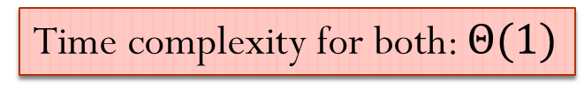
Implementation of Some Operations
makeHeap: set H.min = NULL and H.n = 0
insert: Simply put the node into the root list
Update H.min if necessary
Time complexity for both: $Θ(1)$
H.min
insert(21)
23
7
3
17
24
18
52
38
30
26
46
H.min
39
41
35
23
7
3
21
17
24
18
52
38
30
26
46
39
41
35

Slide 9
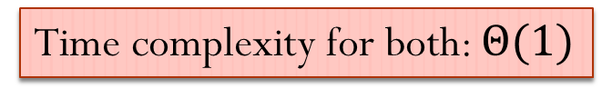
Implementation of Some Operations
getMin: return H.min
union(H₁,H₂): concatenate the root lists of H₁ and H₂ and then determine the new minimum node
H.min
H.min
Time complexity for both: $Θ(1)$
23
7
3
17
24
union
18
52
38
30
26
46
H.min
39
41
35
23
7
3
17
24
18
52
38
30
26
46
39
41
35

Slide 10
insert and extractMin
If we start with an empty Fibonacci heap and then insert k items, the Fibonacci heap would consist of just a root list of k nodes
If nothing else is done, this degrades to a linked list
Fortunately, when we perform an extractMin operation, it will go through the entire root list and consolidate nodes to reduce the size of the root list
Overall idea: the operations on Fibonacci heaps delay work as long as possible

Slide 11
extractMin
Step 1: remove min and concatenate its children into root list
H.min
23
7
x
17
24
3
18
52
38
30
26
46
39
41
35
23
7
18
52
38
17
24
39
41
30
26
46
35

Slide 12
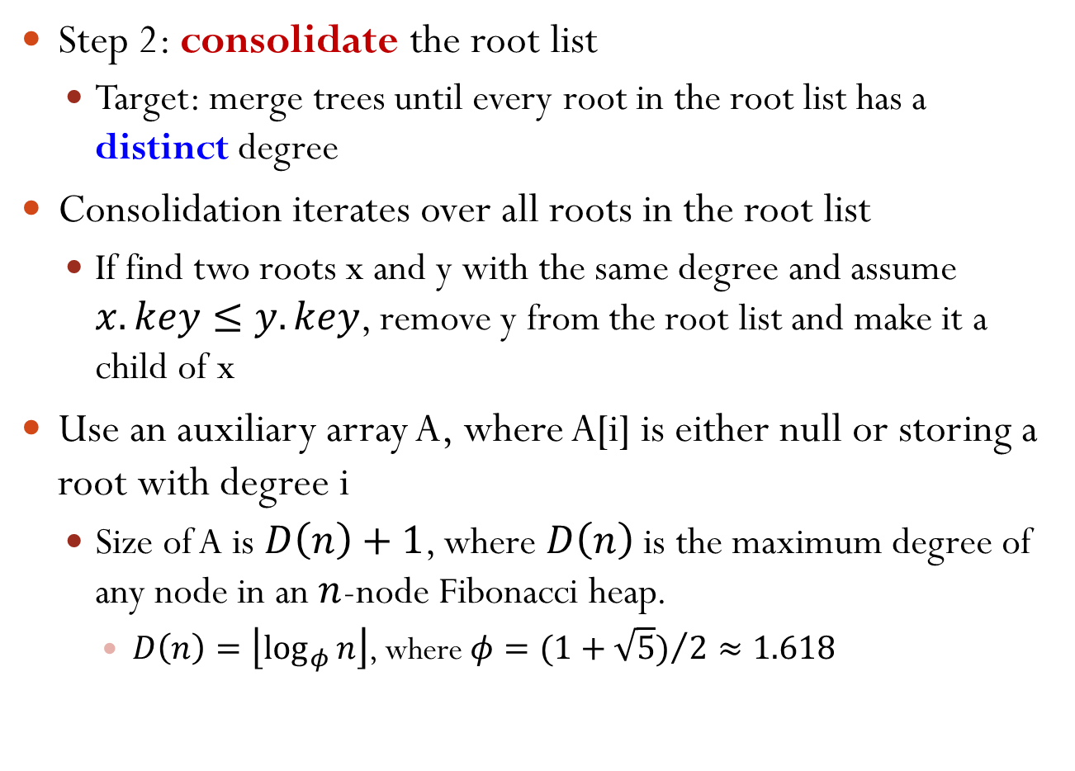
extractMin
Step 2: consolidate the root list
Target: merge trees until every root in the root list has a distinct degree
Consolidation iterates over all roots in the root list
If find two roots x and y with the same degree and assume $x.key≤y.key$, remove y from the root list and make it a child of x
Use an auxiliary array A, where A[i] is either null or storing a root with degree i
Size of A is $D\left(n\right)+1$, where $D\left(n\right)$ is the maximum degree of any node in an $n$-node Fibonacci heap.
$D\left(n\right)=\left\lfloor \log_{φ}{n}\right\rfloor$, where $φ={(1+\sqrt{5})}/{2≈1.618}$

Slide 13


Consolidating Illustration
$D\left(n\right)=\left\lfloor \log_{φ}{13}\right\rfloor =5$
0 1 2 3 4 5
A
$$−$$ | $$−$$ | $$−$$ | $$−$$ | $$−$$ | $$−$$
23
7
18
52
38
17
24
39
41
30
26
46
35

Slide 14

Consolidating Illustration
Start from the right node of the original H.min, i.e., root 17
0 1 2 3 4 5
A
$$−$$ |  | $$−$$ | $$−$$ | $$−$$ | $$−$$
23
7
18
52
38
17
24
39
41
30
26
46
35

Slide 15

Consolidating Illustration
Next root to check is 24
0 1 2 3 4 5
A
$$−$$ |  |  | $$−$$ | $$−$$ | $$−$$
23
7
18
52
38
17
24
39
41
30
26
46
35

Slide 16

Consolidating Illustration
Next root to check is 23
0 1 2 3 4 5
A
 |  |  | $$−$$ | $$−$$ | $$−$$
23
7
18
52
38
17
24
39
41
30
26
46
35

Slide 17
Consolidating Illustration
Next root to check is 7, with degree 0
but we already have a root with degree 0 , i.e., 23. So, merge
0 1 2 3 4 5
A
 |  |  | $$−$$ | $$−$$ | $$−$$
23
7
18
52
38
17
24
39
41
30
26
46
35

Slide 18
Consolidating Illustration
Merge tree 23 with tree 7. This creates a root of degree 1
but we already have a root with degree 1, i.e., 17. So, merge again
0 1 2 3 4 5
A
$$−$$ |  |  | $$−$$ | $$−$$ | $$−$$
7
18
52
38
17
24
23
39
41
30
26
46
35
Notes:
Merge two trees: larger root as a child of the smaller root

Slide 19

Consolidating Illustration
Merge tree 17 with tree 7. This creates a root of degree 2
but we already have a root with degree 2, i.e., 24. So, merge again
0 1 2 3 4 5
A
$$−$$ | $$−$$ |  | $$−$$ | $$−$$ | $$−$$
7
18
52
38
24
17
23
39
41
26
46
30
35
Notes:
The merged tree is a min heap.

Slide 20

Consolidating Illustration
Merge tree 24 with tree 7. This creates a root of degree 3
It is unique. So, we put the new root into A[3]
0 1 2 3 4 5
A
$$−$$ | $$−$$ | $$−$$ |  | $$−$$ | $$−$$
7
18
52
38
24
17
23
39
41
26
46
30
35

Slide 21

Consolidating Illustration
Next root to check is 18, with degree 1
0 1 2 3 4 5
A
$$−$$ |  | $$−$$ |  | $$−$$ | $$−$$
7
18
52
38
24
17
23
39
41
26
46
30
35

Slide 22

Consolidating Illustration
Next root to check is 52, with degree 0
0 1 2 3 4 5
A
 |  | $$−$$ |  | $$−$$ | $$−$$
7
18
52
38
24
17
23
39
41
26
46
30
35

Slide 23
Consolidating Illustration
Next root to check is 38, with degree 1
but we already have a root with degree 1, i.e., 18. So, merge
0 1 2 3 4 5
A
 |  | $$−$$ |  | $$−$$ | $$−$$
7
18
52
38
24
17
23
39
41
26
46
30
35

Slide 24

Consolidating Illustration
Merge tree 38 with tree 18. This creates a root of degree 2
It is unique. So, we put the new root into A[2]
0 1 2 3 4 5
A
 | $$−$$ |  |  | $$−$$ | $$−$$
7
18
52
24
17
23
38
39
All the roots have been visited. Consolidation completes
26
46
30
41
35

Slide 25
extractMin
Step 3: link all the roots in array A together; update H.min
0 1 2 3 4 5
A
 | $$−$$ |  |  | $$−$$ | $$−$$
H.min
7
18
52
24
17
23
38
39
26
46
30
41
35

Slide 26
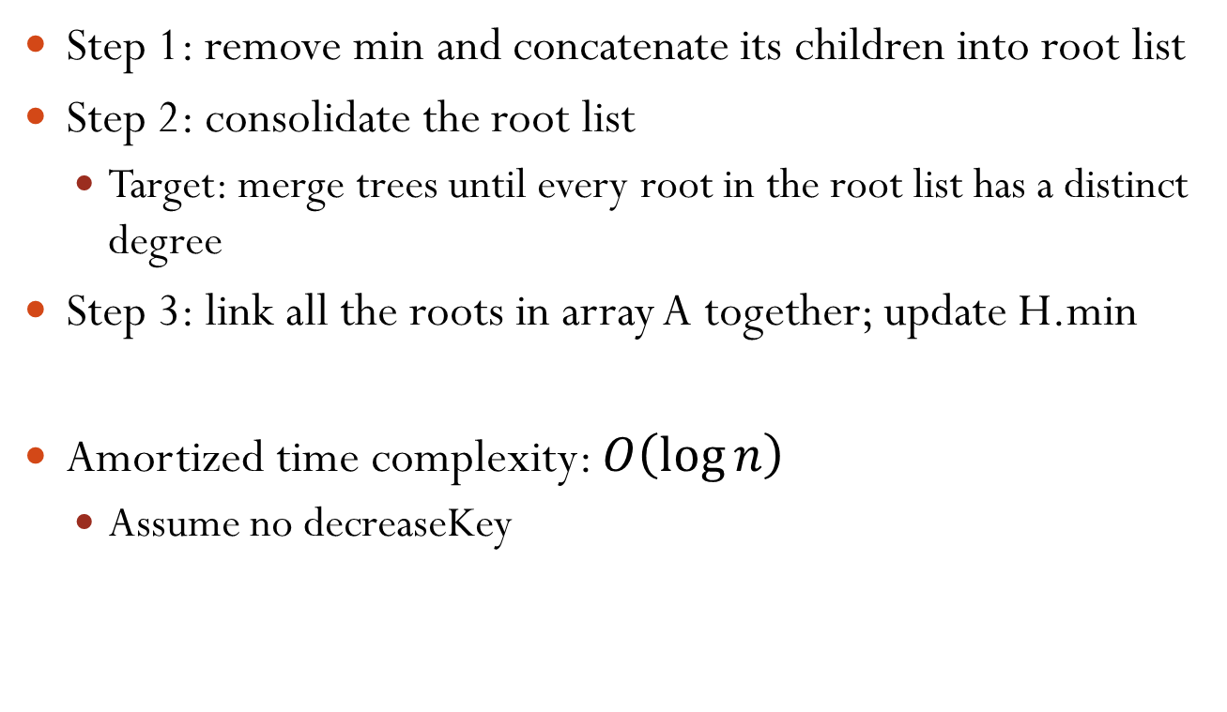
extractMin: Summary
Step 1: remove min and concatenate its children into root list
Step 2: consolidate the root list
Target: merge trees until every root in the root list has a distinct degree
Step 3: link all the roots in array A together; update H.min
Amortized time complexity: $O\left(\log{n}\right)$
Assume no decreaseKey

Slide 27
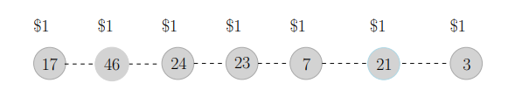
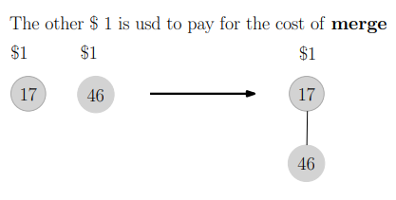
Amortized Analysis of extractMin
At every insert, give every node a credit
Each merge of a node to another, consume the node $1 credit

Slide 28
Amortized Analysis of extractMin
Merge is free!
Prepaid at insertion

Slide 29
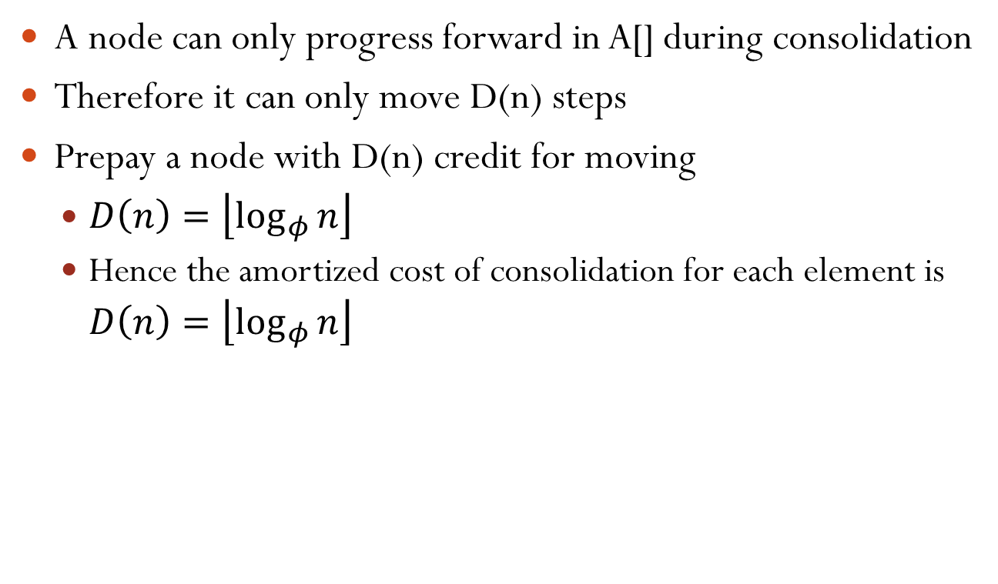
Amortized Analysis of extractMin
A node can only progress forward in A[] during consolidation
Therefore it can only move D(n) steps
Prepay a node with D(n) credit for moving
$D\left(n\right)=\left\lfloor \log_{φ}{n}\right\rfloor$
Hence the amortized cost of consolidation for each element is $D\left(n\right)=\left\lfloor \log_{φ}{n}\right\rfloor$

Slide 30

Amortized Analysis of extractMin
Find new min:
Iterate through A[]
$D\left(n\right)=\left\lfloor \log_{φ}{n}\right\rfloor$ steps
Overall, the amortized cost of extractMin over each element is $O(\log{n})$

Slide 31

Amortized Analysis of extractMin
Maximum number of nodes in a tree:
Merge with a copy of itself:

Slide 32
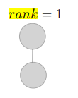
Amortized Analysis of extractMin
Maximum number of nodes in a tree:
Merge with a copy of itself:

Slide 33
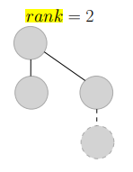
Amortized Analysis of extractMin
Maximum number of nodes in a tree:
Merge with a copy of itself:

Slide 34
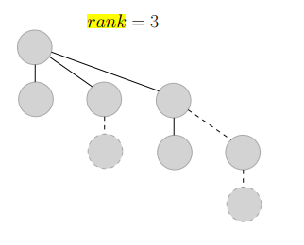
Amortized Analysis of extractMin
Maximum number of nodes in a tree:
Merge with a copy of itself:

Slide 35
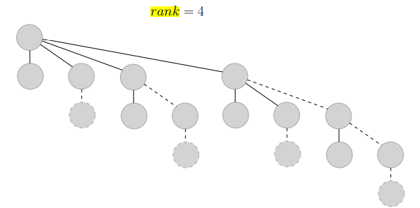
Amortized Analysis of extractMin
Maximum number of nodes in a tree:
Merge with a copy of itself:

Slide 36
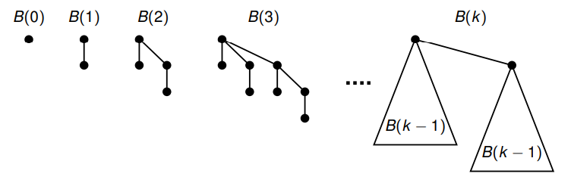
Amortized Analysis of extractMin
Maximum number of nodes in a tree:
S(n) = S(n-1) + S(n-2)
Also called binomial trees!

Slide 37
decreaseKey
Case 1: min heap property not violated
Only need to change H.min pointer if necessary
7
18
52
24
17
23
38
39
26 → 25
26
46
30
41
25
35

Slide 38
decreaseKey
Case 2: min heap property violated
Solution
Step 1: Cut between the node and its parent
Step 2: Move the subtree to the root list
Change H.min pointer if necessary
7
18
52
26 → 15
24
17
23
38
39
15
7
18
52
15
30
41
26
46
35
24
17
23
38
39
35
46
30
41

Slide 39
decreaseKey
A special note: if a node n not in the root list has lost a child for the second time, the subtree rooted at n should also be cut from n’s parent and move to the root list
46 → 10
15
7
18
52
15
10
7
18
52
35
24
17
23
38
39
35
24
17
23
38
39
46
41
30
41
10
30
24 has already lost one child
Now 24 has lost child for the second time, we need to cut it

Slide 40
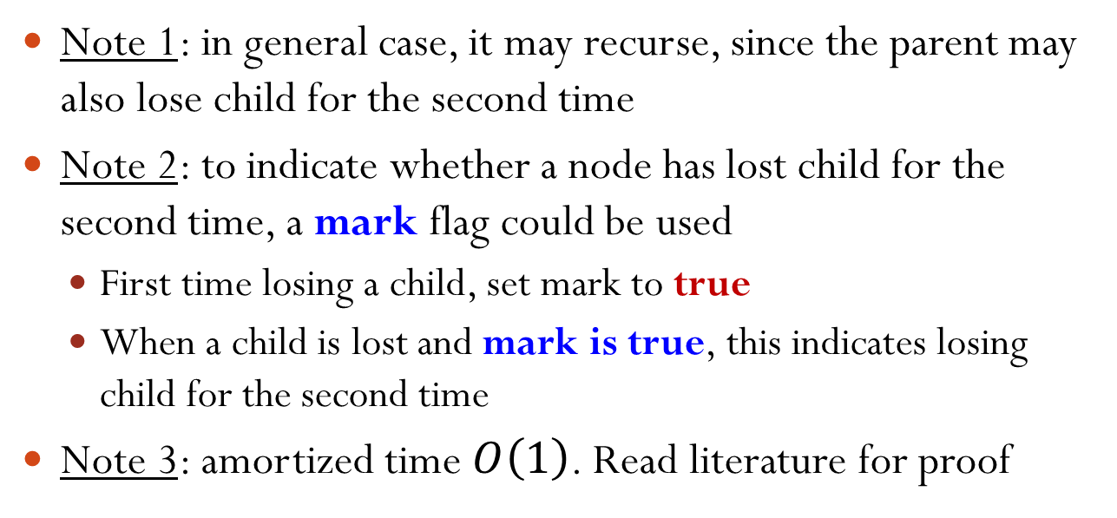
decreaseKey
15
10
7
18
52
15
10
24
7
18
52
35
24
17
23
38
39
35
17
23
38
39
30
41
30
41
Note 1: in general case, it may recurse, since the parent may also lose child for the second time
Note 2: to indicate whether a node has lost child for the second time, a mark flag could be used
First time losing a child, set mark to true
When a child is lost and mark is true, this indicates losing child for the second time
Note 3: amortized time $O\left(1\right)$. Read literature for proof

